Slide 1
FINAL PROJECT
Class: ECE 5831
Professor: Dr. Azeem Hafeez
Name: Jonathen Robey

Slide 2
Motivation
Demonstrate the ability to use class material in a real life scenario
Complete a ML project from preprocessing data to obtaining a decent classification rate.

Slide 3
Introduction
This projects specific goal is to be able to classify which CAN signal belongs to which ECU so that it can be determined if the incoming signal belongs to the expected ECU. This is useful in determining if your vehicle has been hijacked.
  Preprocess the Data
  Use a training set on a ML model to determine how to classify CAN signal
  Test classification criteria on test set to check accuracy

Slide 4
Feature Set
Feature set for Method 1:
  Gaussian Distributed Analysis
  Standard Deviation, Mean, Error
Feature set for Method 2:
  Regression Model
  Exponential Decay Function
  Average MSE

Slide 5
Method 1: GDA
Store the Mean and STD of each time stamp of the training set
For each test signal, for each ECU data set, record the absolute value of the data set minus the mean of the current ECU data set.
Record true if the test set is greater than 3.2 STD from the Mean data set.
Convert logic to binary (1 = true, 0 = false)
Sum the binary matrix
The ECU data that has the least number of points outside of 3.2 STD is the ECU that the test set is classified as.

Slide 6
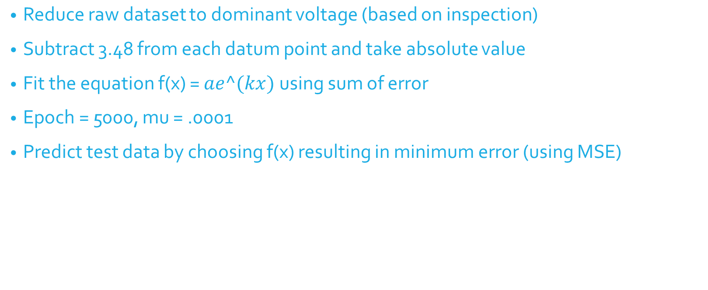
Method 2: Regression Model

Slide 7
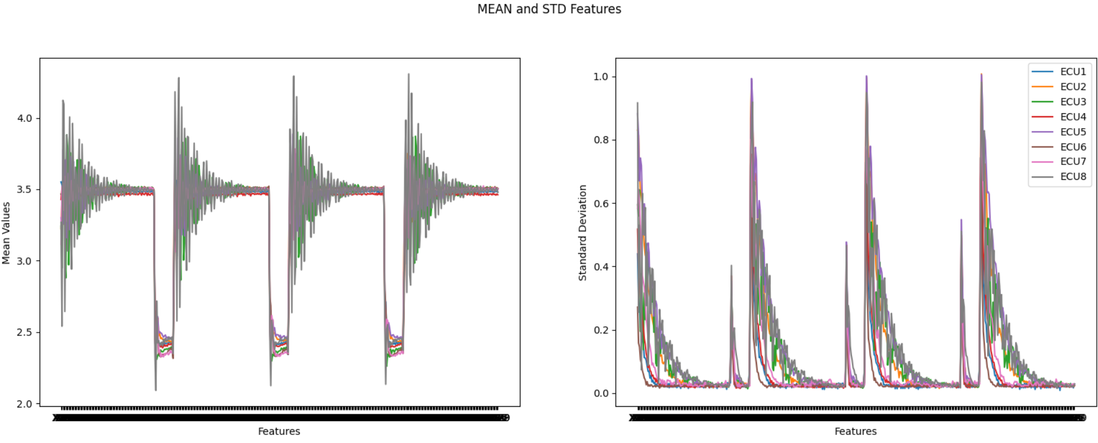
Results: Method 1
Accuracy: Between 70-80%
Computational Time: 1-3 seconds

Slide 8
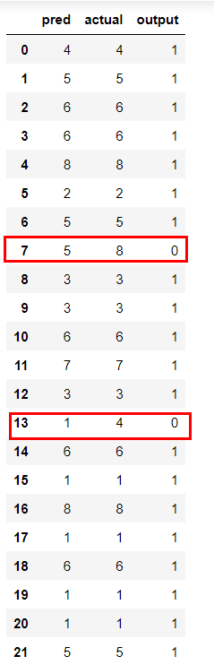
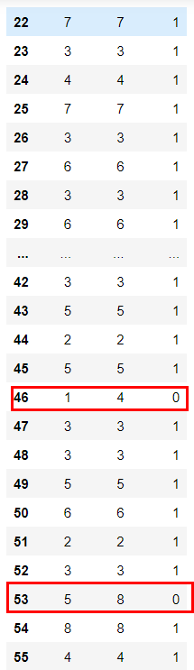
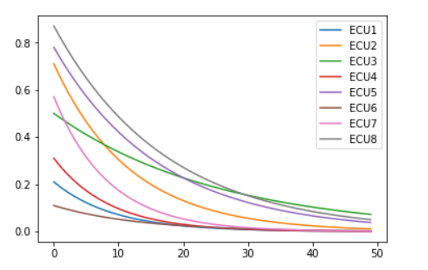
Results: Method 2
Accuracy: Typically greater than 90%
Computational time: 18 minutes

Slide 9
Comparison
Method 1 is less accurate but computationally quicker
Method 1 is greatly influenced by the test/training set while method 2 is consistent
Method 1 has the flexibility to use all, most, or a portion of the raw dataset

Slide 10
Conclusion
Method 2 produced more accurate classification
Method 1 has shown that average isn’t a good feature and STD is…OK
Preprocessing data without inspection is difficult
Improving preprocessing or adding another feature may improve results

Slide 11
Improvements
Preprocessing of Data
Assign likelihood to method 1 instead of choosing the minimum and add another feature.
Include the ‘a’ term as a randomized weight in method 2
Add decay rate (k) as another feature in method 2
Experiment with both methods using the FFT
Possibly apply regression model to the STD data in method 1

Slide 12
Questions?

